Slide 1
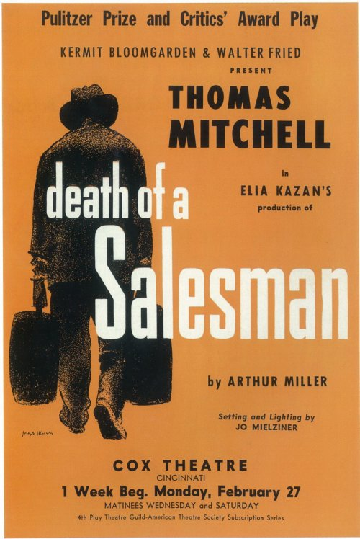
Bryce

Slide 2
The American Dream
The American Dream

Slide 3
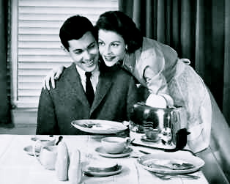

Slide 6
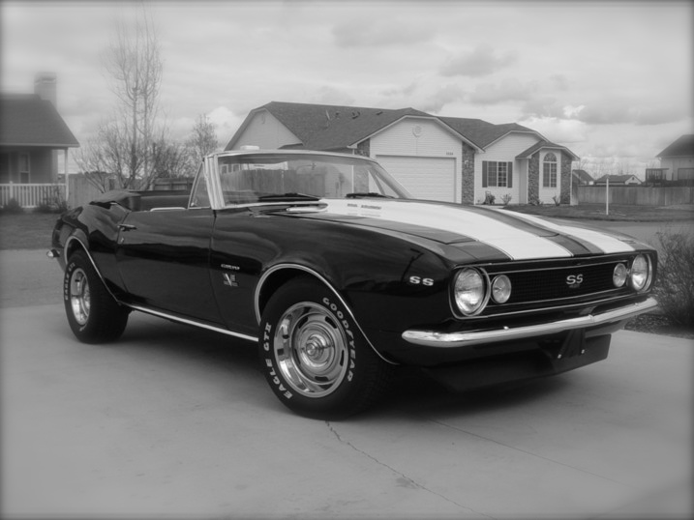

Slide 8
These are what most people think of when they hear the phrase “The American Dream”

Slide 9
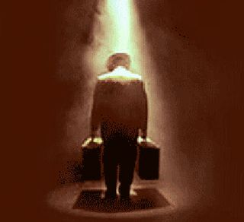
MOST people.
With the exception of Willy Loman……..

Slide 10
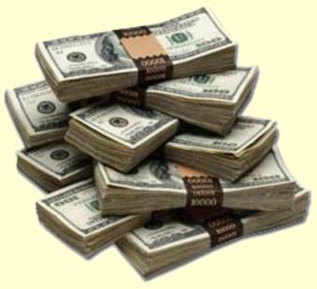
He has a defective version of the American Dream.
One that involves material items and nothing else.

Slide 11
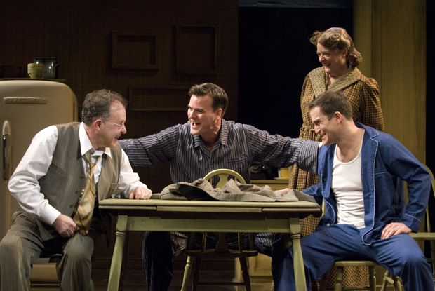
Not even friends,
Or family…..
Are included In this vision.

Slide 12
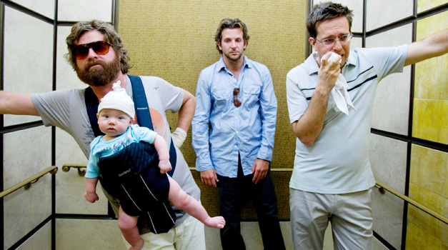
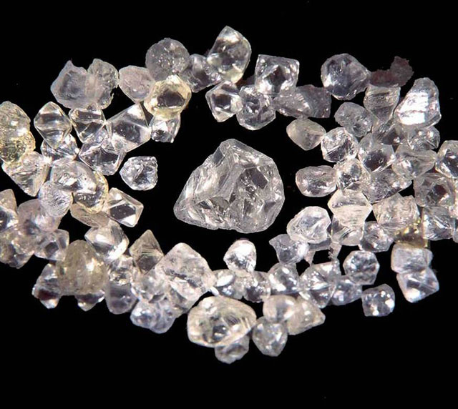
He believes this can be achieved with a combination of being well-liked and sheer dumb luck like his brother, Ben.
“The man who makes an appearance in the business world, the man who creates personal interest, is the man who gets ahead. Be liked and you will never want.” (Act 1)
“The man knew what he wanted and went out and got it! Walked into a jungle, and comes out, the age of twenty-one, and he's rich!” (Willy Loman on Ben, Act 1)

Slide 13
What’s worse is he even attempts to shape his two sons, Biff and Happy to be mirror images of him.

Slide 14
At first when they were young they accepted this ideology.
But as they matured, Biff started to realize that money and items meant very little to him.
And so Willy’s expectations of Biff began to push them apart.

Slide 15
In contrast, Happy embraced Willy’s flawed philosophy.
And as a result becomes lonely, unhappy, and depressed.

Slide 16
So Willy’s idea of the American Dream doesn’t produce happiness, and he squanders his whole life chasing this faulty dream.
This also makes Willy extremely depressed, and he feels like his life has no direction or purpose……

Slide 17
Willy absolutely refuses to admit that his way of thinking is wrong, and that this dream is unachievable. So he simonizes his achievements to preserve his dignity.

Slide 18
His life then turns into a false illusion and his mind breaks down into a thousand pieces. This turns him into just a crazy old man trying to pin down an impossible goal.

Slide 19
So, in all, the American Dream is an unachievable feat for many people that will tear family and friends apart, and will likely shatter individuals.
Arthur Miller is using Willy Loman as a tool to condemn the American Dream.

Slide 20
The End

