Slide 1
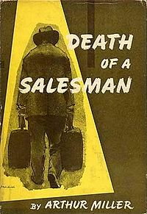
Death of a Salesman
By: Brandon Brown

Slide 2
Willy Loman’s
American Dream

Slide 3
The “American Dream” revolves around everybody being created equal and having equal opportunities for success

Slide 4
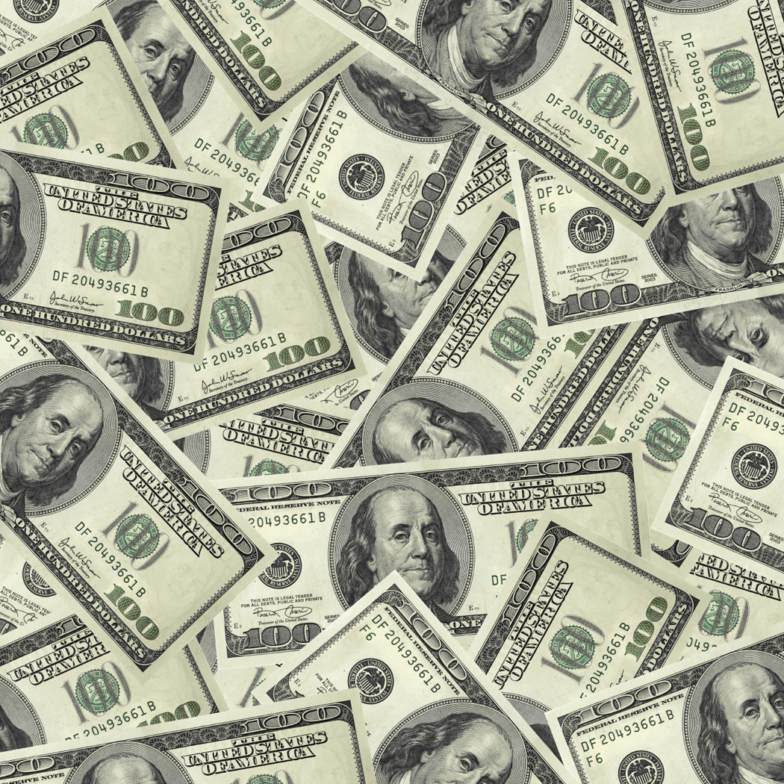
Willy’s Idea of the American Dream is a combination of wealth and being number one, doing one better then the next guy.

Slide 5
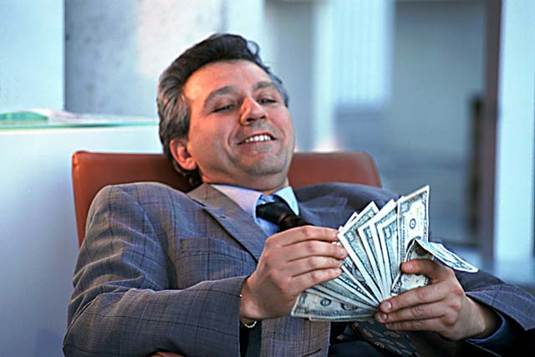
"The man knew what he wanted and went out and got it! Walked into a jungle and comes out, the age of twenty-one, and he's rich!”
(Willy referring to Ben)

Slide 6
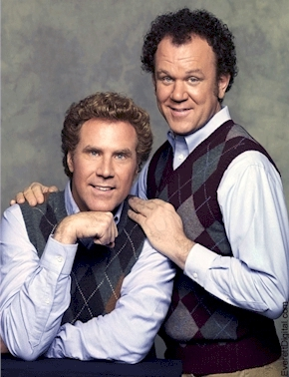
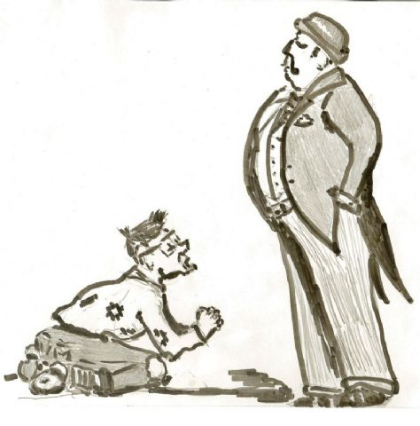
Willy’s brother Ben achieved this “dream” that Willy so heavily believed in, and he worships him for it.
Ben’s success has just gone on to bolster and validate Willy’s false idea of the American Dream

Slide 7
Willy believes that he has also reached his goal and was a huge success in his prime

Slide 8
“In 1928 I had a big year. I averaged a hundred and seventy dollars a week in commissions” (Willy to his employer Howard)
Obviously this was only in Willy’s dream land
He never came close to moving that much merchandise.

Slide 9
To Willy this is completely legitimate, whenever someone questions his success, Willy Loman slips into his own world were all his dreams are reality

Slide 10
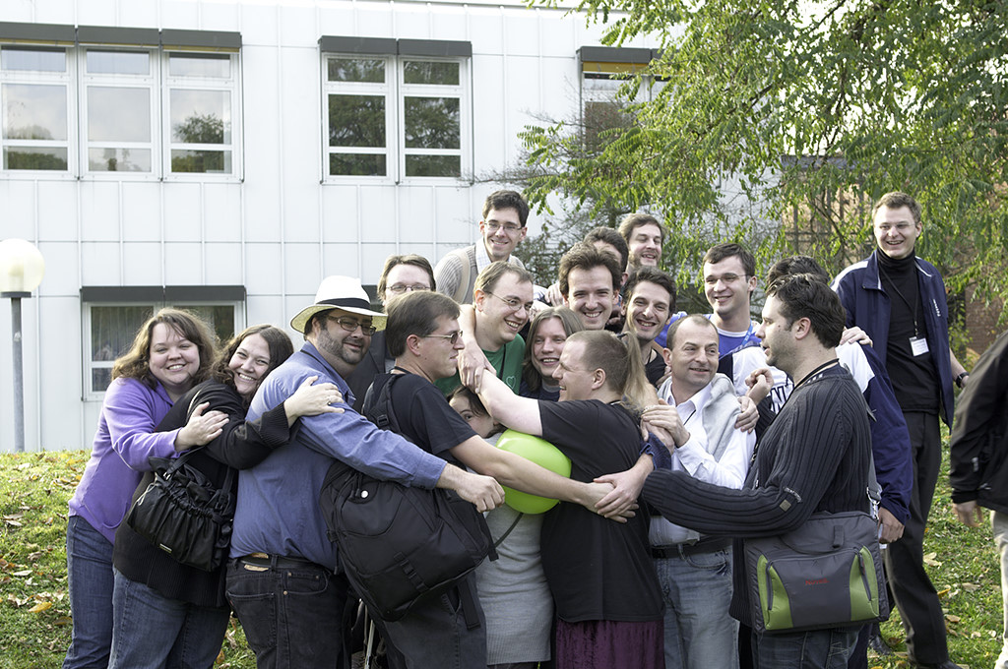
The second aspect to Willy’s version of the “American Dream” is that to make it in this world you have to be well liked and respected by everyone.

Slide 11
"He's liked, but he's not well liked."

Slide 12
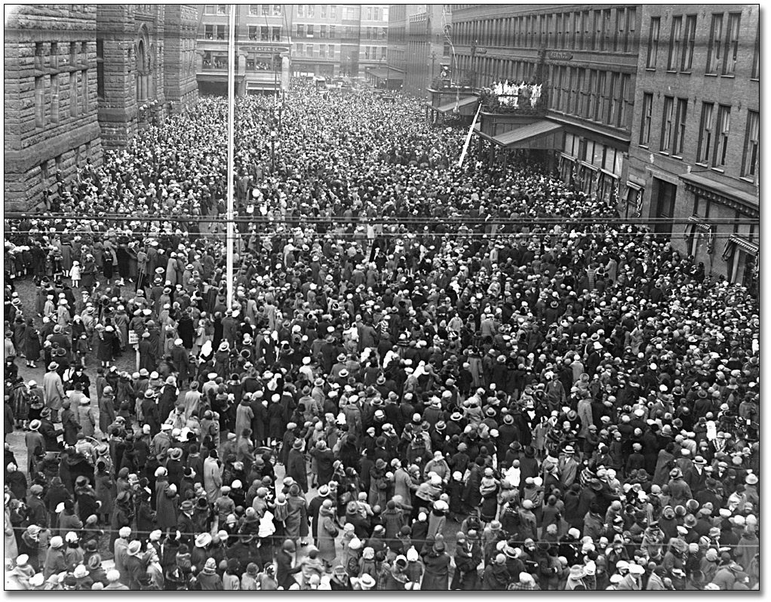
“That funeral will be massive! They'll come from Maine, Massachusetts, Vermont, New Hampshire! All the old-timers with the strange license plates -- that boy will be thunderstruck!”
(Willy speaking about Biff’s reaction to his funeral)

Slide 13
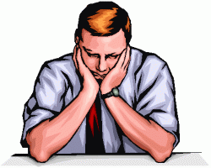
Possibly Willy’s greatest dream is to be remembered when he is gone, to be “known” as he calls it.
Willy Loman…

Slide 14
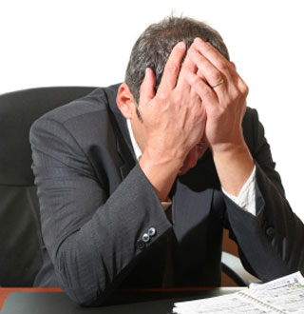
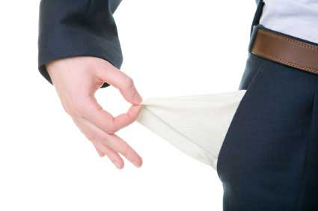
Not only does Willy struggle with the concept that he has not achieved these milestones,
But he is constantly tormented by the realization that his son, Biff, is heading down an even worse path then himself.

Slide 15
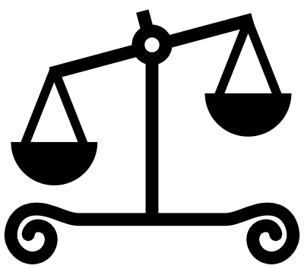
Is this dream.. This ideal life that Willy has laid out for himself really worth the collapse of the relationship with his sons?

Slide 16
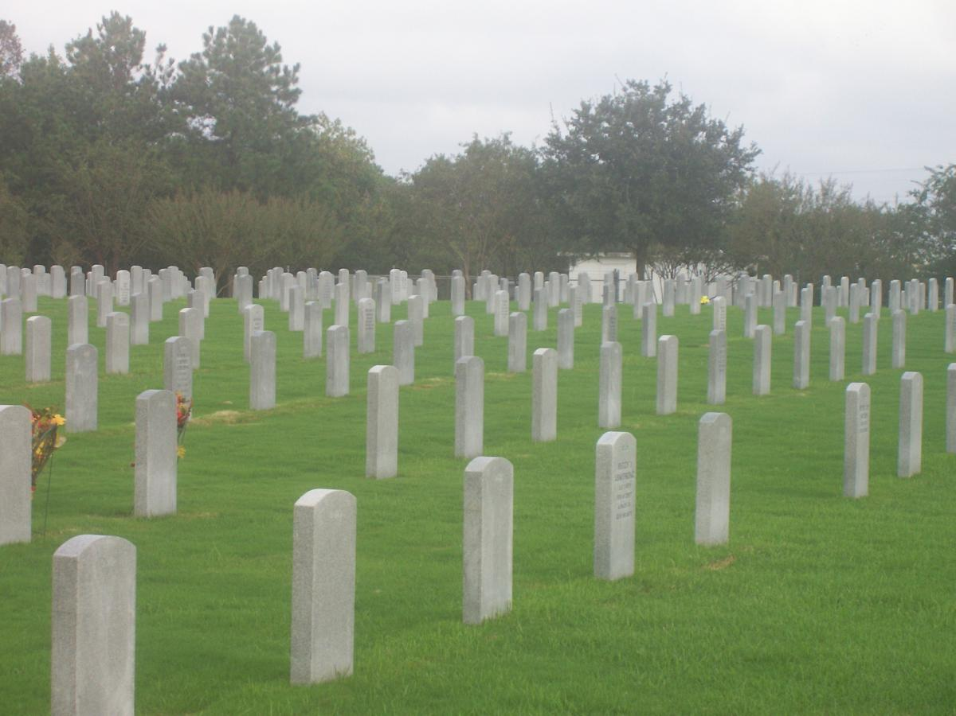
Or even possibly his own life?

Slide 17
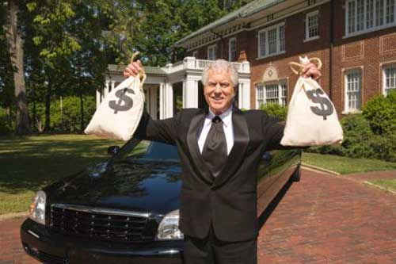
Willy will never allow himself, or his son’s for that matter to enjoy a normal life until he is satisfied that his standard of life has been met!

Slide 18
Which Will Come First?
The Question Is…

Slide 19
OR

