Slide 1
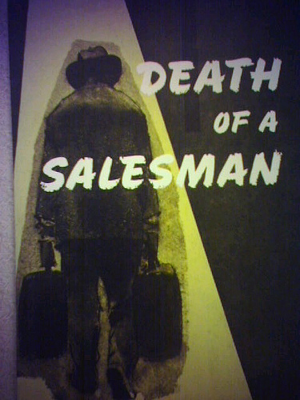
By Tori

Slide 2

How do parents influence one’s values, worldview and morals?
Greatest amount of time spent with our parents.
They are the ones we see the most and imitate the most.
Notes:
For most of us the greatest amount of time is spent with our parents.
Parents are the people they see the most and imitate the most.

Slide 3
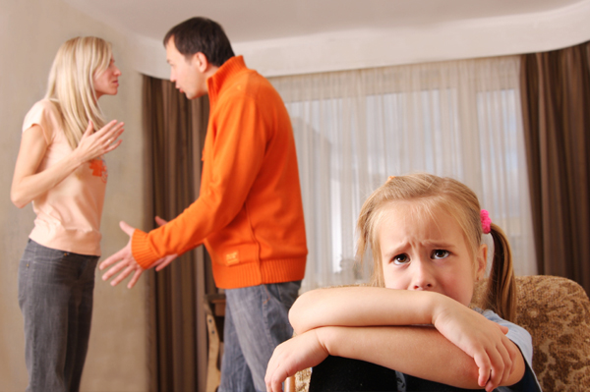
If a child is brought up with hate and violence, they might become violent also.
We are the product of our environment.
Numerous serial killers come from violent homes
Notes:
Parents can influence how their children behave and act everyday. If a child is brought up with hate and violence they might become violent people that hate everybody.
We are the product of our environment and parents help shape that.
Numerous serial killers come from violent homes.

Slide 4

When a parent is caring and respectful to others it teaches the children to behave in the same manner.
Children will contribute to society and treat others well.
Notes:
Parents strongly influence ones values and beliefs, especially in their children. When a parent is loving and caring and respectful to others it teaches the child to behave in the same manner.
Children will become contributing members of society and treat others how they will want to be treated.

Slide 5

Parents with a higher level of education are also more likely to help their children learn and stress the importance of school.
Parents with degrees= kids with degrees
Notes:
Parents with a higher level of education are also more likely to believe strongly in their abilities to help their children learn.
Children who come from homes with higher education tend to earn more college and university degrees.

Slide 6

  Children who see their parents volunteering will help out without expecting to get paid.
  Good citizenship traits are passed down from parent to child.
Notes:
Children who see their parents volunteering will help out without expecting to get paid.

Slide 7

Parents who treat each other well, model the importance of good relationships.
Notes:
Parents who treat each other well, model the importance of good relationships for their children to follow.

Slide 8

Parents values of taking care of themselves will be passed to their children.
Parents that follow healthy habits will lead to children with healthy habits.
Notes:
Parents values of taking care of themselves such as eating right and exercising will be passed to their children.
Parents that follow healthy habits will usually lead to children with these healthy habits.

Slide 9
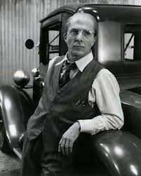
From death of a salesman
Willy greatly influenced his two sons Biff and Happy.
Success is a product of being “well-liked.”
A charming personality will get you out of any problem.
Notes:
Willy greatly influenced his two sons Biff and Happy in Death of a Salesman.
Willy convinces himself and his sons that success is a product of being well-liked.

Slide 10
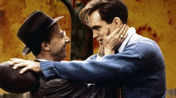
Willy encourages competitive and unlawful behaviour.
Ex. Biff steals football
Ex. Biff gets fired from a job because he is accused of stealing basketballs.
Notes:
Willys biggest flaw is he neglects to realize all the negative values he has instilled in his sons. He encourages compettive and unlawful behaviour.
Example is when Biff steals the football from the locker room and Willy defends him.

Slide 11

Willy teaches his sons, the more money you make the more successful you are.
Biff just wants to work outside in the open, instead of an office.
Notes:
Willy also teaches his sons the more money you make, the more successful you are.
This causes problems for Biff as he just wants to work outside in the open instead of an office.

Slide 12
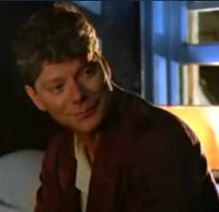
Happy is also looking for his fathers approval but never receives it.
Tries for his dads approval
Notes:
Happy is not satisfied with his life but never changes anything because all he wants to do is please his father. He must Constantly strive to impress his father.
His dads lack of approval motivates him, as seeking a parents approval is very important to a child.

Slide 13
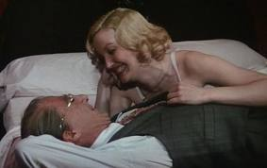
Biff’s image of his dad was broken when he spotted him having an affair with The Woman.
Biff lost trust in his father and realized he is not as perfect as he thought.
Notes:
Biff’s image of his dad was broken when he spotted him having an affair with The Woman. He thought the world of him and when he saw this he gave up all hope.

Slide 14
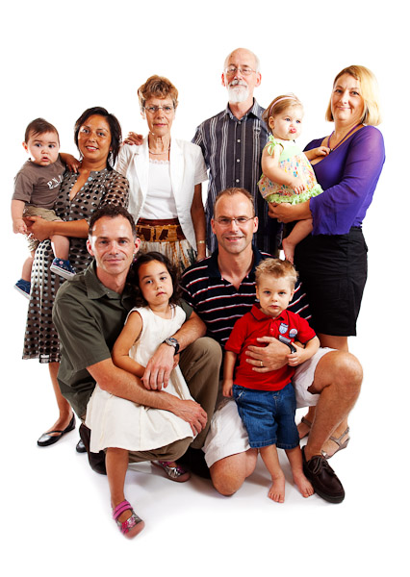
Whether its from the Lomans generation or today’s generation, parents have always had a great impact on their children.
Notes:
Whether its from the Lomans generation or today’s generation parents have always had a great impact on their children.

